Slide 1
Kaggle Two-Sigma Apartment Interest Project
Project Team: Emil Parikh, Glen Ferguson, and Jason Chen

Slide 2
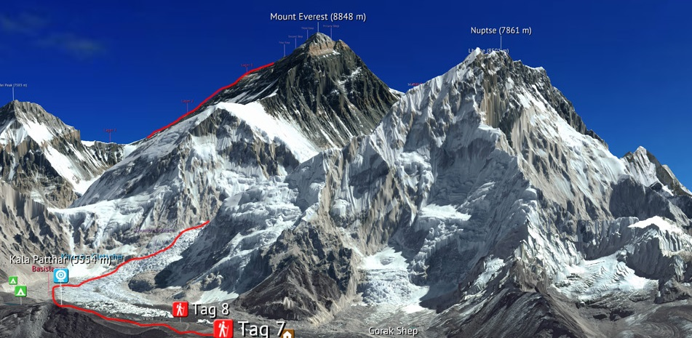
EDA: Mount Everest

Slide 3

EDA: Burj Khalifa

Slide 4
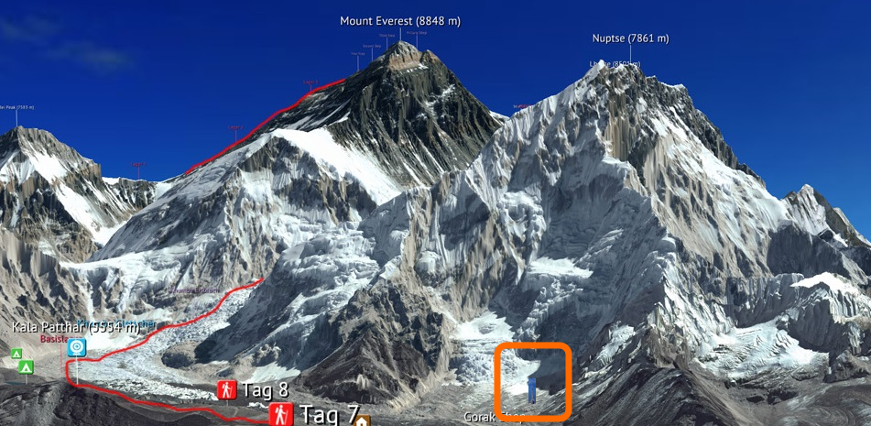
EDA: Everest vs Burj

Slide 5
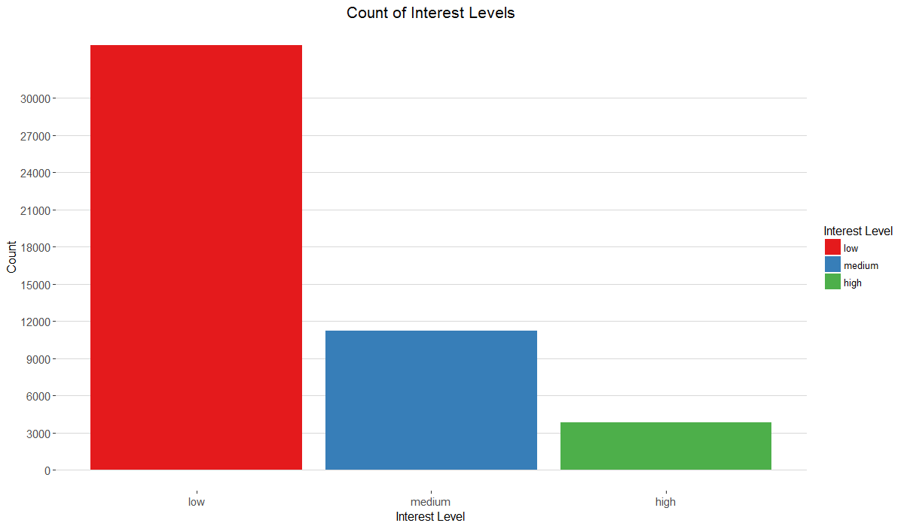
EDA: Count of Interest Levels

Slide 6
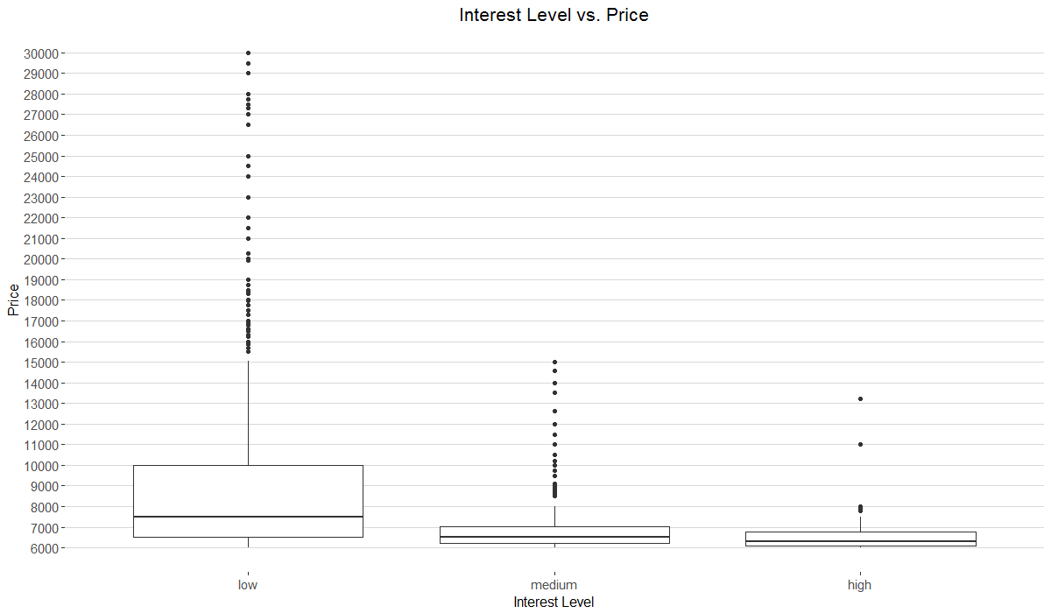
EDA: Interest Level vs. Price

Slide 7
EDA: Simple Features
Total: 49,352
Low: 34,284 Medium: 11,229 High: 3,839
25%: $2,500 50%: $3,150 75%: $4,100 100%: $4,490,000

Slide 8
EDA: Complex Features
Not all of the features could be analyzed immediately
Photos: number of photos
Features: number of features
Description: character count of description

Slide 9
Feature Engineering: Photos
Number of photos: 276,714
Luminance: 0.2126R + 0.7152G + 0.0722B
Source: Wikipedia: Relative Luminance
Mean and standard deviation of RGB

Slide 10
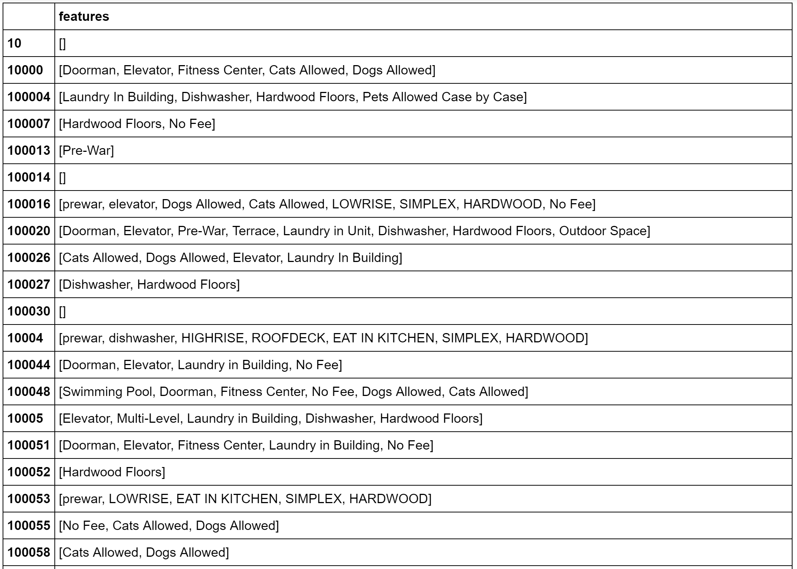
Features
List format
Many features with the same meaning
‘pre-war’ vs ‘pre war’
‘laundry’ vs ‘dryer/washer’

Slide 11
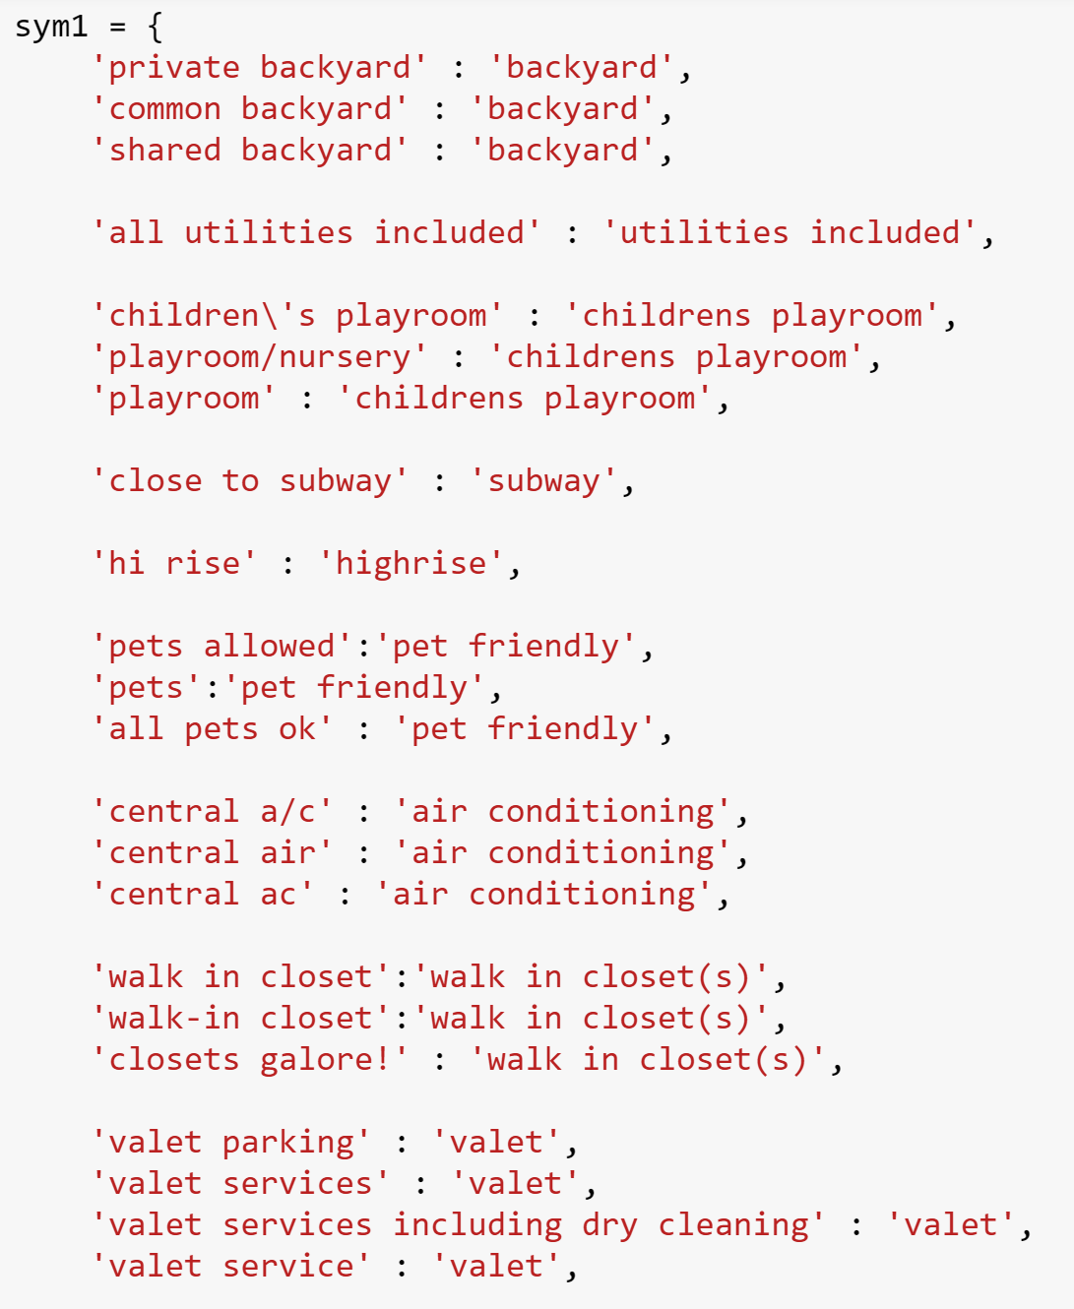
Features
Standardize feature names
Count vectorized with tfidf
Created 400 columns
Too many columns for grid searching RF
How did we reduce dimensionality?

Slide 12
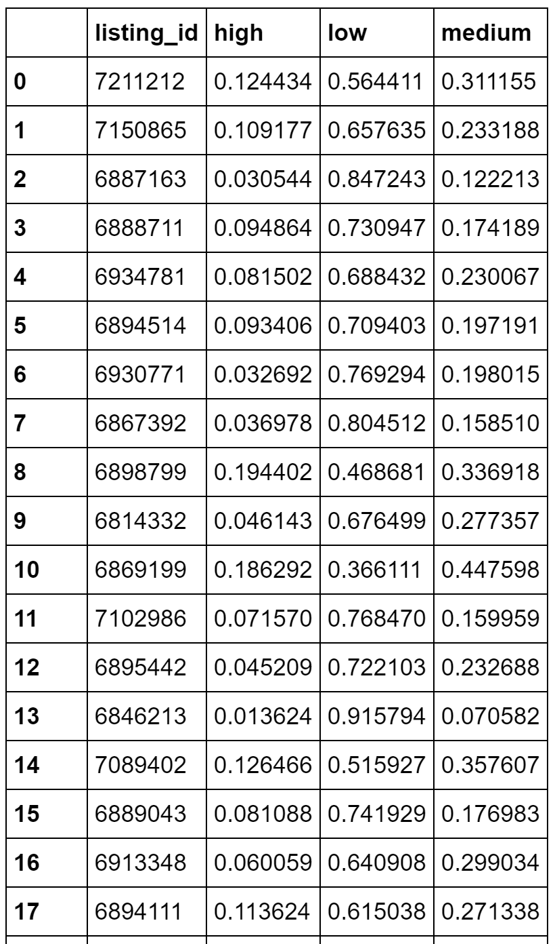
Features
Performed a logistic regression using only the 400 columns of features
Used the predictions as new predictors for base model

Slide 13
Description Variable
The description variable was unstructured html
"Spacious 1 Bedroom 1 Bathroom in Williamsburg!Apartment Features:- Renovated Eat in Kitchen With Dishwasher- Renovated Bathroom- Beautiful Hardwood Floors- Lots of Sunlight- Great Closet Space- Freshly Painted- Heat and Hot Water Included- Live in Super Nearby L, J, M & G Trains !<br /><br />Contact Information:Kenneth BeakExclusive AgentC: 064-692-8838 Email: kagglemanager@renthop.com, Text or Email to schedule a private viewing!<br /><br /><br /><br /><br /><br /><br /><br /><br /><br /><br /><br /><br /><br /><br /><br /><p><a website_redacted”
NLP from the tidytext package
The Ngrams (short phrases) from the library
Used SVM to classify, but this had no predictive power
Sentiment analysis
A column of the word counts for each sentiment, positive, negative, anticipation, fear, anger, joy, disgust, sadness, surprise, and trust
Positive was by far the most important!
aberration abhor abhorrent abject abnormal disgust

Slide 14
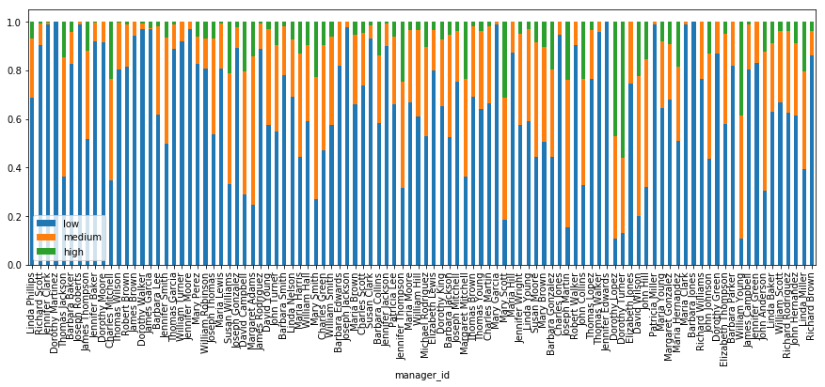
Manager ID
Based on a Kaggle Kernel, the Kernal has now been signficantly changed
Results in severe overfitting based on difference between validation score and Kaggle score.
Since the output was used to determine the fit there is leakage

Slide 15
Variable Importance

Slide 16
Correlation Plot Final Variables

Slide 17
Models
Tuning models provided limited benefit in all cases!
Logistic Regression
Ridge
Elastic Net
Standard implementations don’t predict high values even with CV
Not good at predicting medium
Random Forest (7 variables)
Ranger Implementation
Much faster than randomForest package
Very poor at predicting medium
H2O Gradient Boosting
Better at predicting high values, not as good at predicting lower values

Slide 18
Models – Logistic with Ridge

Slide 19
Models – Ranger

Slide 20
Models – GBM

Slide 21
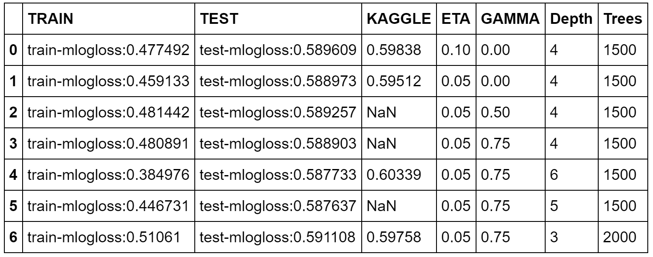
XGBoost
Made decent predictions out of the box (relative to other models)
Lots of tuning parameters
Not very feasible to do a full grid search under a time constraint
Difficult to tune
Slower learning rate improved Kaggle score
Overfit due to depth
Underfit due to depth

Slide 22
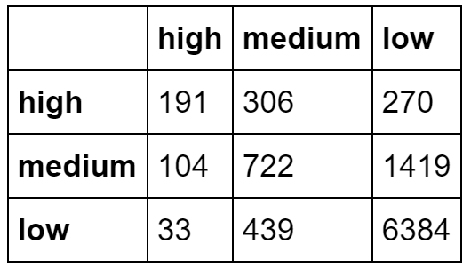
XGB Base Model

Slide 23
Models: Addressing the class imbalance
Down-sampling
Sample majority classes
Information loss
Up-sampling
Sample minority class with replacement
Fit all of the models on each of base, up-, and down-sampled data

Slide 24
Models: Ensembling
None of the models added more than the predictions from the three XGBoost models, so we only used XGBoost on:
Full data
Accurately predicted the most low interest levels
Accurately predicted the least high interest levels
Up-sampled data
Accurately predicted the most high interest levels
Accurately predicted the least low interest levels
Down-sampled data
Next best for both high and low

Slide 25
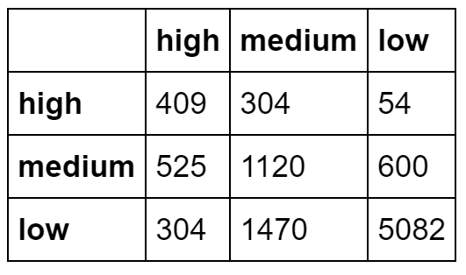
Down-sampled XGB

Slide 26
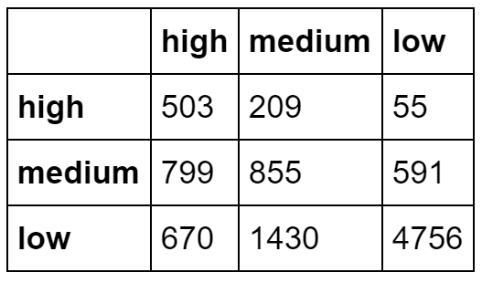
Up-sampled XGB

Slide 27
Conclusions
Class imbalances and the Logloss metric rewarded models that fit low preferentially with some medium
Using up/down sampling of the data is is possible to increase accuracy
Increasing the accurate of high interest predictions
They tend to be worse at predicting medium interest
Feature engineering to improve classification of medium and high interest properties is important for model accuracy

